Slide 1

BudgetBuddy
Safura Shafi Kunuth Siddiqui
Salwa Sarwer Vimal Sebastian
Terrance Li Manab Sthapit
Mateilda Chahine Eduardo Hernandez

Slide 2
Project Objective
Assist users in managing their savings and expenses effectively.
Provide a stress free financial management app catering to the needs of both students and adults.
Incorporate features that balance personal spending with academic or professional expenses.
Offer interactive elements for Financial education.
Implement Agile methods for development and continuous improvement.

Slide 3
Cost Estimation
Hardware | Software | Personnel
Amazon EC2 On-Demand Cloud Hosting $60.74/month Amazon EBS Cloud Storage $16.00/month AWS Data Transfer In & Out $9.00/month | BitBucket $24.00 Jira, MySQL (GPL License) $0.00 Plaid (Secure Third-Party Bank Linking API) $500/month | Team of 8 Software Engineers $60,000 × 8 = $480,000/year
$85.74/month | $524.00/month | $40,000/month

Slide 4
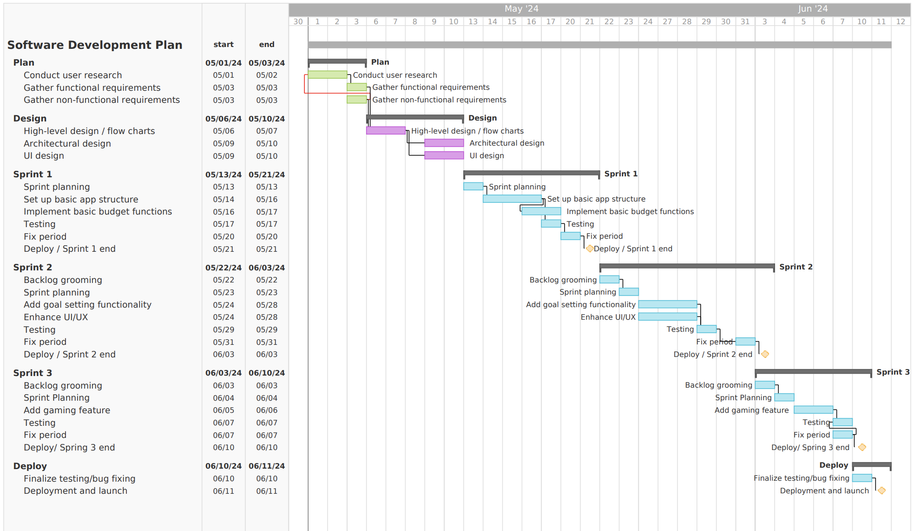
Project Timeline

Slide 5
Functional Requirements - Users
Users
Users should be able to log into the system
Users should be able to sync bank information to account
Users should be able to set personal budget
Users should be able to set personal goals
Users should be able to play financial education game
Users should be able to track transactions, budget progress, and goals

Slide 6
Non-Functional Requirements
Product Requirements
Usability: 5-minute tutorial
Efficiency: fast and lightweight
Dependability: <5% fail events
Security: device-based authentication
Organizational requirements
Environmental: common OSes and mobile devices
Operational: bank key requirement for linking checking account
Developmental: Git
Notes:
Non-functional Requirements:
· Product Requirements
o Usability Requirements – a user shall be able to use all systems after a five-minute tutorial. After the tutorial, the experienced user-error rate shall not exceed 3 per hour of application use.
o Efficiency Requirements
§ Performance Requirements – the response time between user input (button press, transaction adding/editing, etc.) shall not exceed 30ms (the app should be efficient, so minimizing the delay while giving leeway for sending information across the internet are the factors considered when determining this requirement).
§ Space Requirements – the app shall not exceed 3 Gigabytes in size (the app should be lightweight so as not to be a burden on a computer system).
o Dependability Requirements – the app shall have <5% of events cause failure. The app shall also maintain a backup of data in the case of data corruption.
o Security Requirements – users shall only be able to use the app on a device after the user has been verified via email or phone (this app deals with sensitive information. It should make sure the user’s identity is verified).
· Organizational Requirements
o Environmental Requirements – the app shall be runnable from Mac, Windows, Linux, iPhone, and Android devices. If necessary, separate versions of the app shall be to accommodate the different device environments.
o Operational Requirements – users shall request for a key from the bank that manages their checking account(s) before linking the account to their app (again, to maintain the security of the application, users should link sensitive information on their own terms).
o Developmental Requirements – the app versions shall be maintained and controlled through a Git repository. Developers will be promptly added and removed from the repository as they enter and leave development (the repository will also allow the app to be rolled back in the case of severe development failures).
· External Requirements
o Regulatory Requirements – the app shall follow PCI compliance, or payment card industry compliance. That is, the app shall maintain data encryption and other protective security standards when handling transactions to protect user data.
o Ethical Requirements – the app shall not redistribute any user data. The app shall encrypt and remotely store user data to maintain user privacy.
o Legislative Requirements (assuming the app is developed and published in America)
§ Accounting Requirements – the app shall not track any information that is deemed illegal to use per U.S. privacy laws.
§ Safety/Security Requirements – the app shall obey financial regulations as set forth by the Federal Trade Commission (FTC).

Slide 7
Non-Functional Requirements (cont.)
External Requirements
Regulatory: PCI compliance (data security)
Ethical: data encryption, and no redistribution
Legislative (U.S.)
Accounting: no illegal tracking of information (privacy laws)
Safety/Security: FTC regulations
Notes:
Non-functional Requirements:
· Product Requirements
o Usability Requirements – a user shall be able to use all systems after a five-minute tutorial. After the tutorial, the experienced user-error rate shall not exceed 3 per hour of application use.
o Efficiency Requirements
§ Performance Requirements – the response time between user input (button press, transaction adding/editing, etc.) shall not exceed 30ms (the app should be efficient, so minimizing the delay while giving leeway for sending information across the internet are the factors considered when determining this requirement).
§ Space Requirements – the app shall not exceed 3 Gigabytes in size (the app should be lightweight so as not to be a burden on a computer system).
o Dependability Requirements – the app shall have <5% of events cause failure. The app shall also maintain a backup of data in the case of data corruption.
o Security Requirements – users shall only be able to use the app on a device after the user has been verified via email or phone (this app deals with sensitive information. It should make sure the user’s identity is verified).
· Organizational Requirements
o Environmental Requirements – the app shall be runnable from Mac, Windows, Linux, iPhone, and Android devices. If necessary, separate versions of the app shall be to accommodate the different device environments.
o Operational Requirements – users shall request for a key from the bank that manages their checking account(s) before linking the account to their app (again, to maintain the security of the application, users should link sensitive information on their own terms).
o Developmental Requirements – the app versions shall be maintained and controlled through a Git repository. Developers will be promptly added and removed from the repository as they enter and leave development (the repository will also allow the app to be rolled back in the case of severe development failures).
· External Requirements
o Regulatory Requirements – the app shall follow PCI compliance, or payment card industry compliance. That is, the app shall maintain data encryption and other protective security standards when handling transactions to protect user data.
o Ethical Requirements – the app shall not redistribute any user data. The app shall encrypt and remotely store user data to maintain user privacy.
o Legislative Requirements (assuming the app is developed and published in America)
§ Accounting Requirements – the app shall not track any information that is deemed illegal to use per U.S. privacy laws.
§ Safety/Security Requirements – the app shall obey financial regulations as set forth by the Federal Trade Commission (FTC).

Slide 8
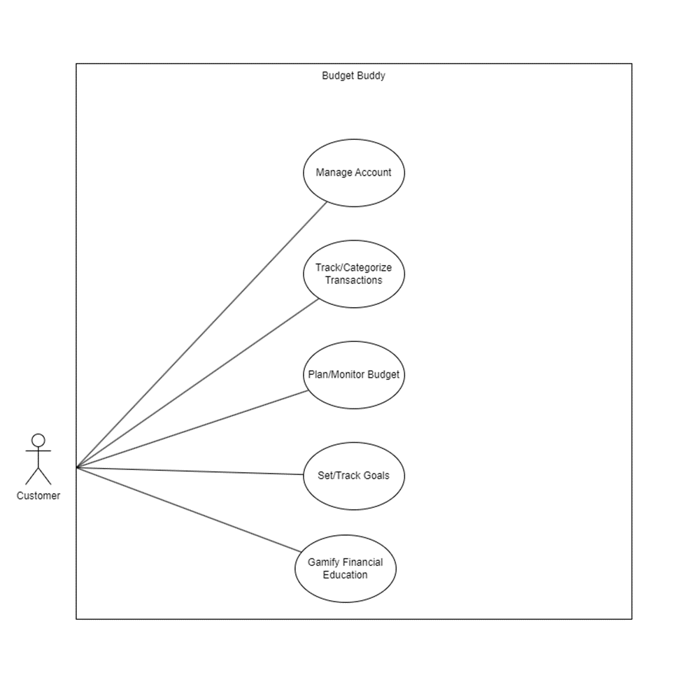
Use Case Diagram
Customer Actor
Manage Account
Track/Categorize Transactions
Plan/Monitor Budget
Set/Track Goals
Gamify (Financial Education) Play Education Games

Slide 9
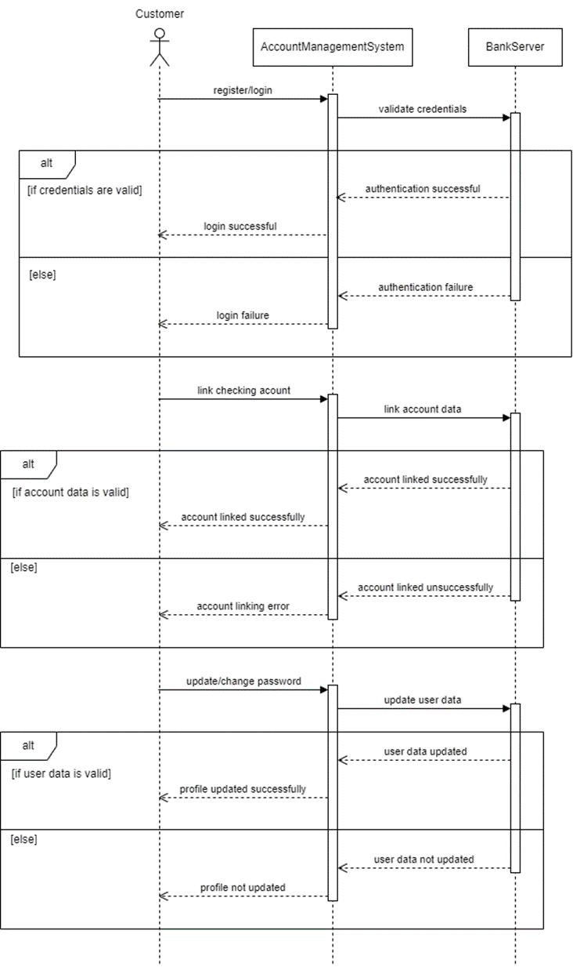
Sequence Diagram
Account Management
Registration
Bank linking
Changing user data (passwords)

Slide 10
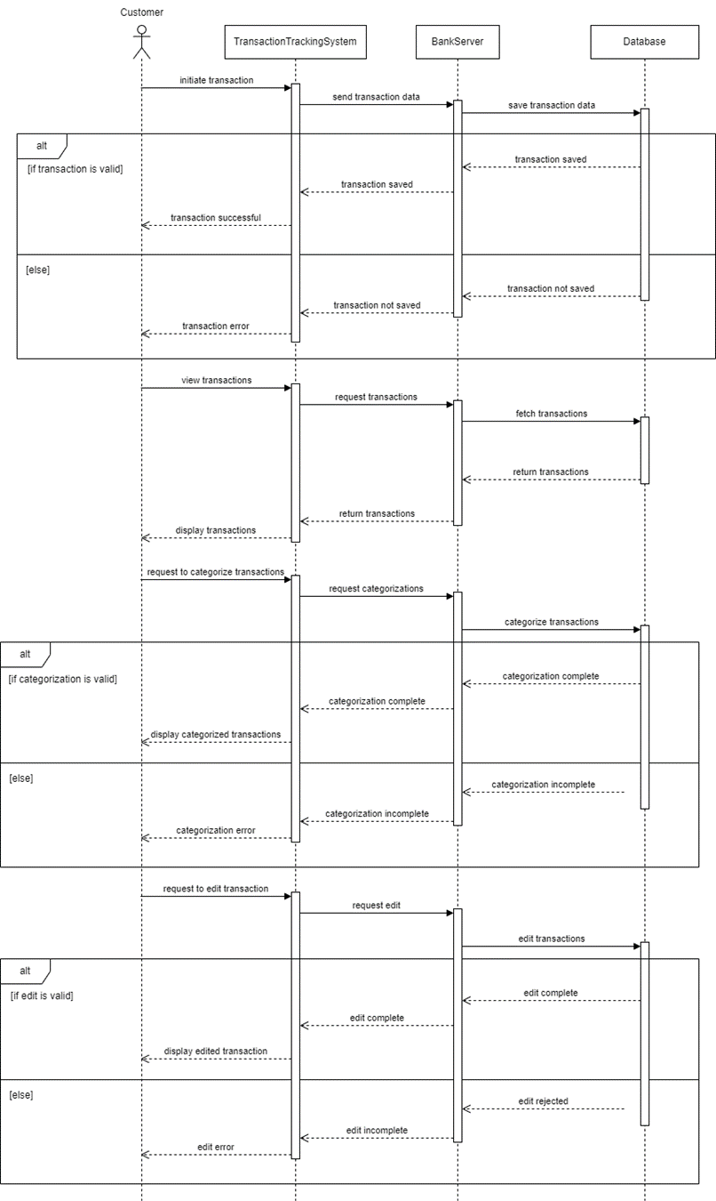
Sequence Diagram (cont.)
Transaction Tracking
Adding Transactions
Editing Transactions
Viewing Transactions
Organizing/Categorizing Transactions

Slide 11
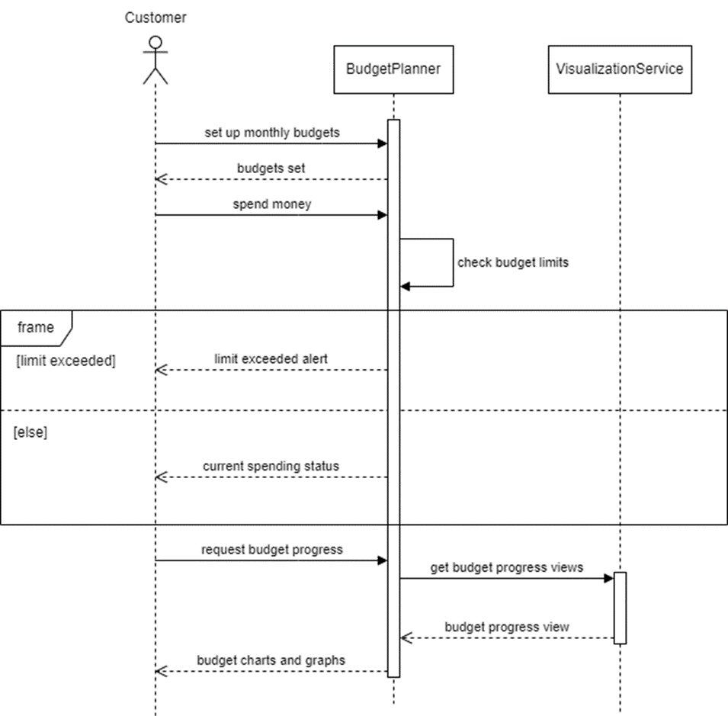
Sequence Diagram (cont.)
Budget Planning
Setting Up Budget
Spending
Check If Limit Exceeded
Seeing Budget Status

Slide 12
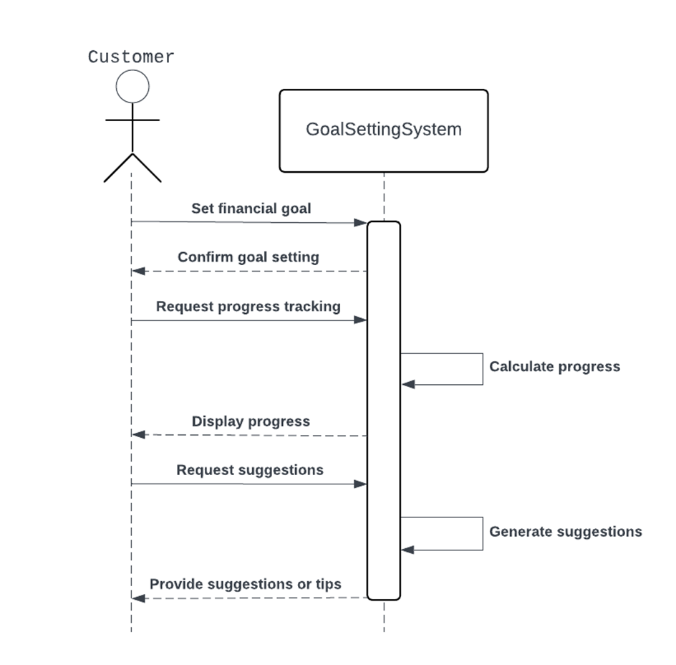
Sequence Diagram (cont.)
Goal Setting
Setting Financial Goals
Checking Goal Progress
Financial Suggestions

Slide 13
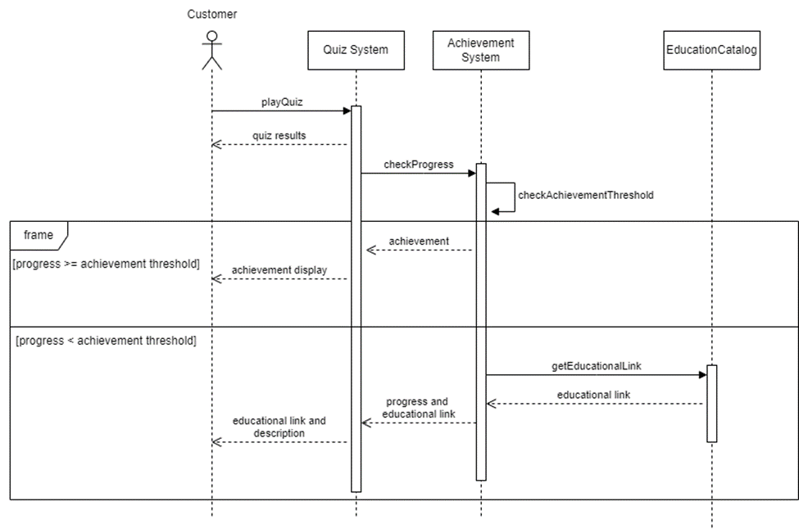
Sequence Diagram (cont.)
Quiz System
Quiz Taking
Achievement Tracking
Educational Articles/ Videos

Slide 14
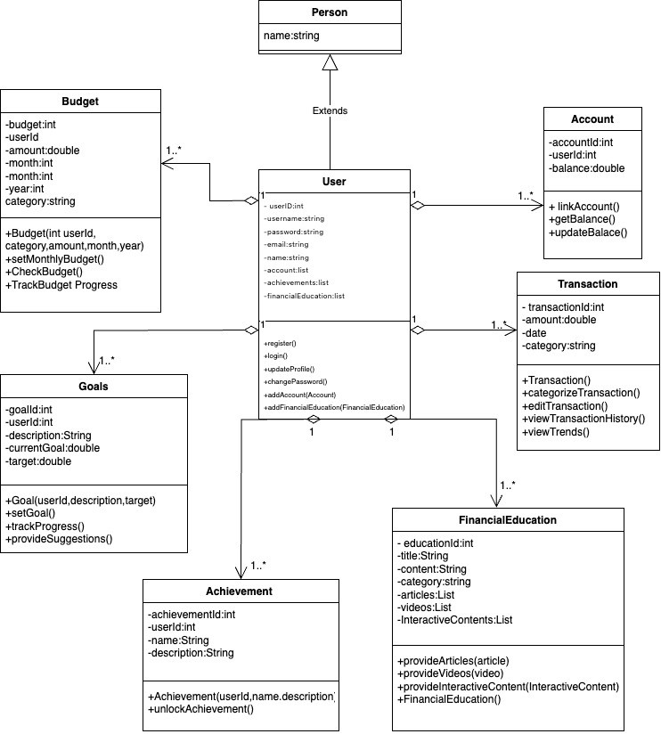
class di
Class Diagram
Multiple aggregational relationships because the user can have these entities, but not have full and absolute ownership over them.
1..* is written because the user can have multiple accounts, goals, budgets, accounts, etc.

Slide 15
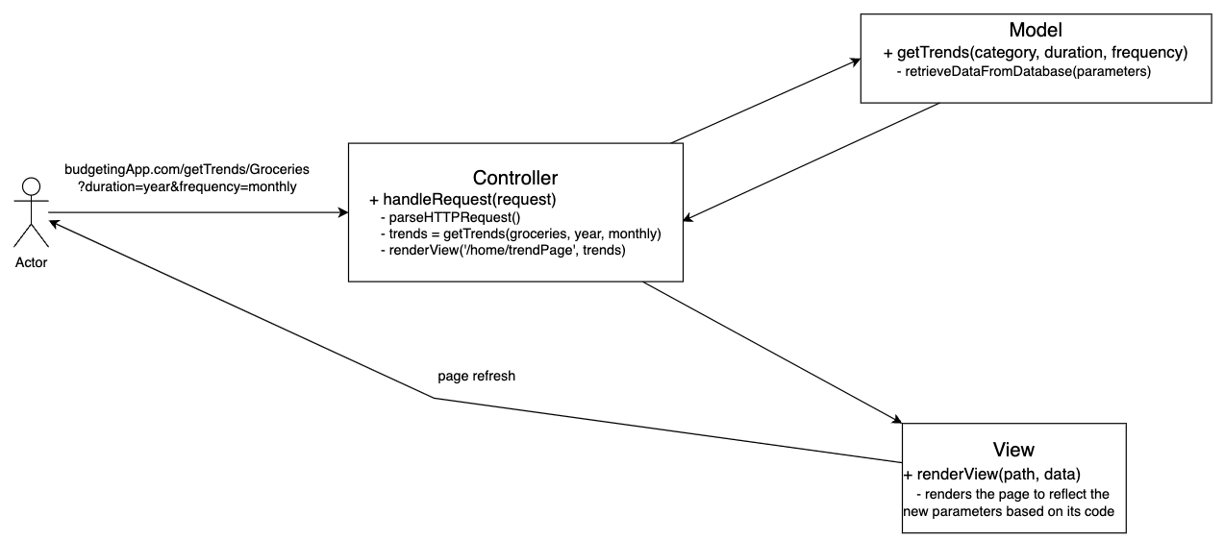
Architectural Design Pattern
Model-View-Controller
Example interaction involving seeing bar graphs of grocery spendings

Slide 16
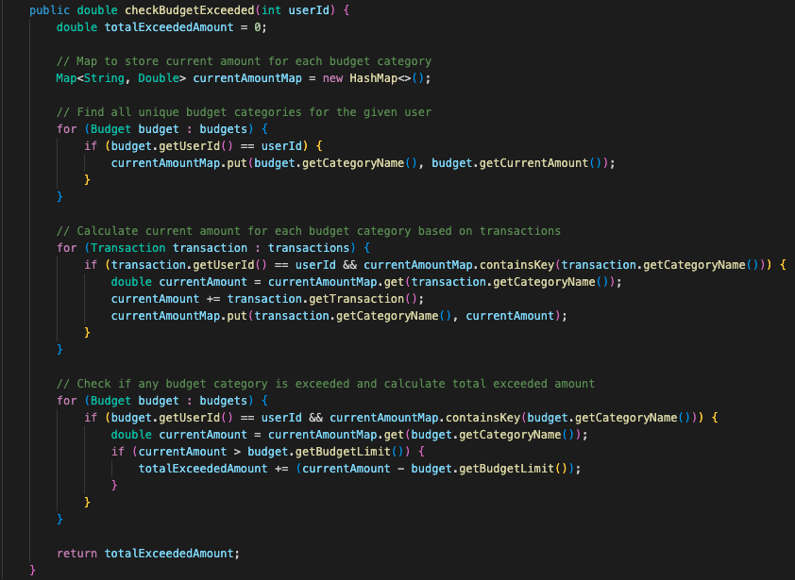
Function Code
Budget
int userId
String categoryName
double budgetLimit
double currentAmount
Transaction
int userId
String categoryName
double transaction

Slide 17
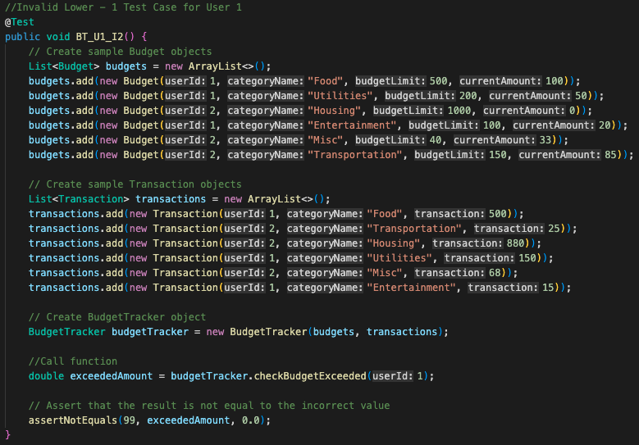
Unit Testing
Test 1: BT_U1_V1:
Valid Output Test Case for User 1’s budgets and transactions exceeded amounts
Test 2: BT_U1_I1:
Test 3: BT_U1_I2:
Test 4: BT_U2_V1:
Test 5: BT_U2_I1:
Test 6: BT_U2_I2:

Slide 18
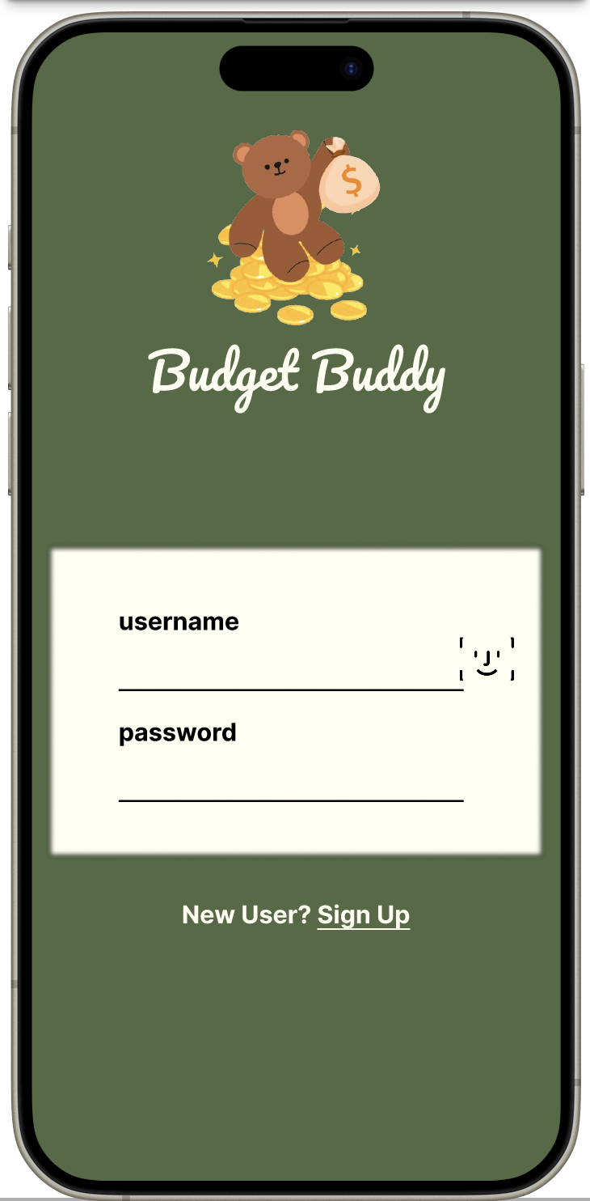
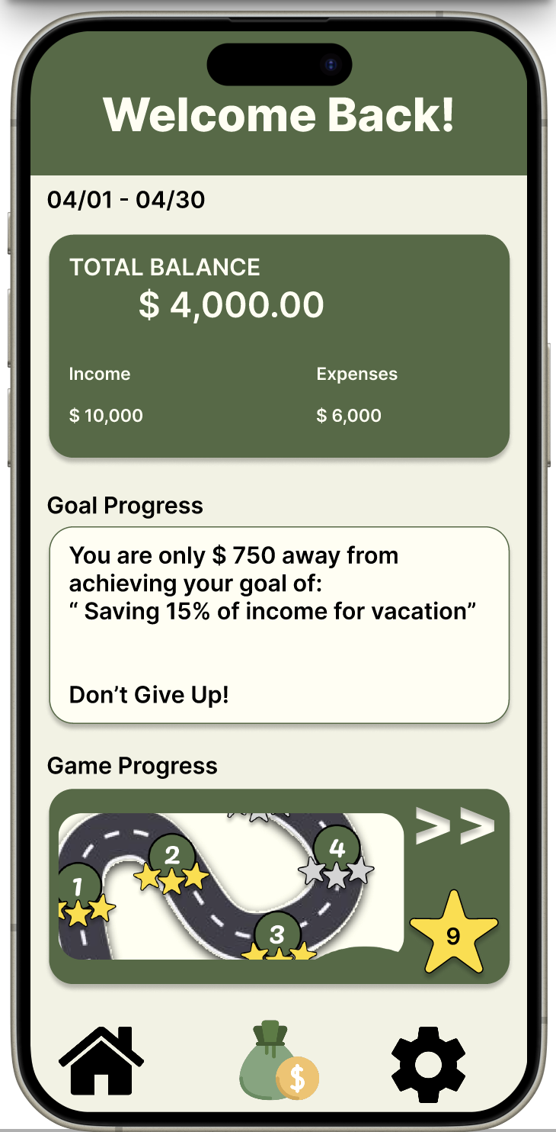
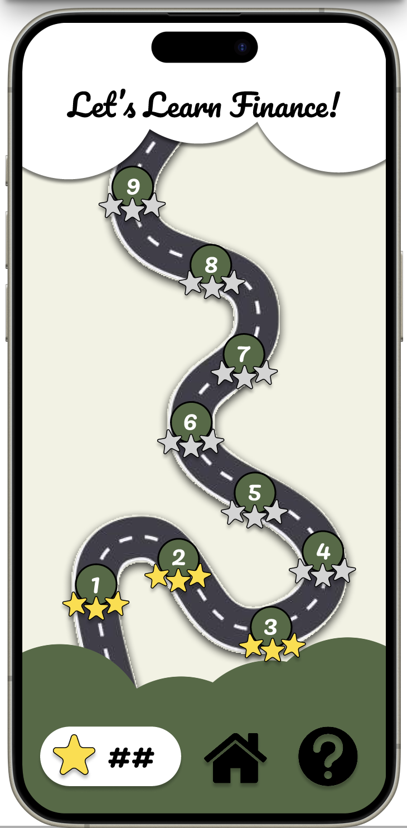
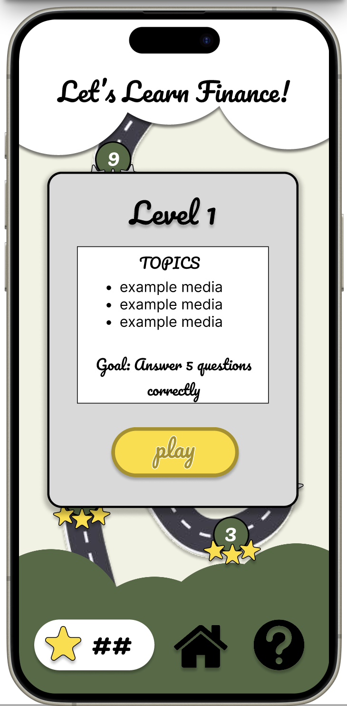
Demos

Slide 19
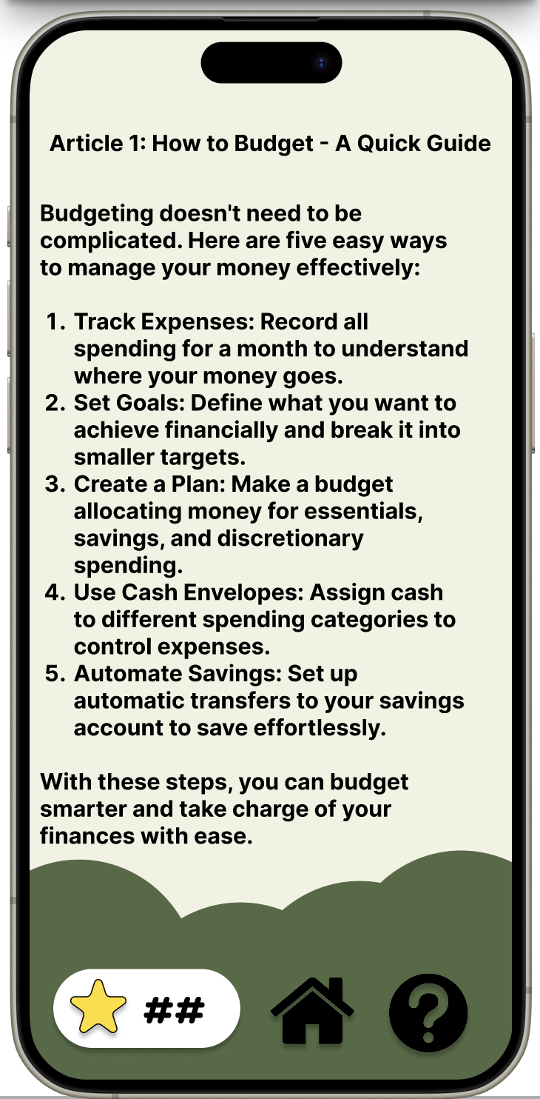
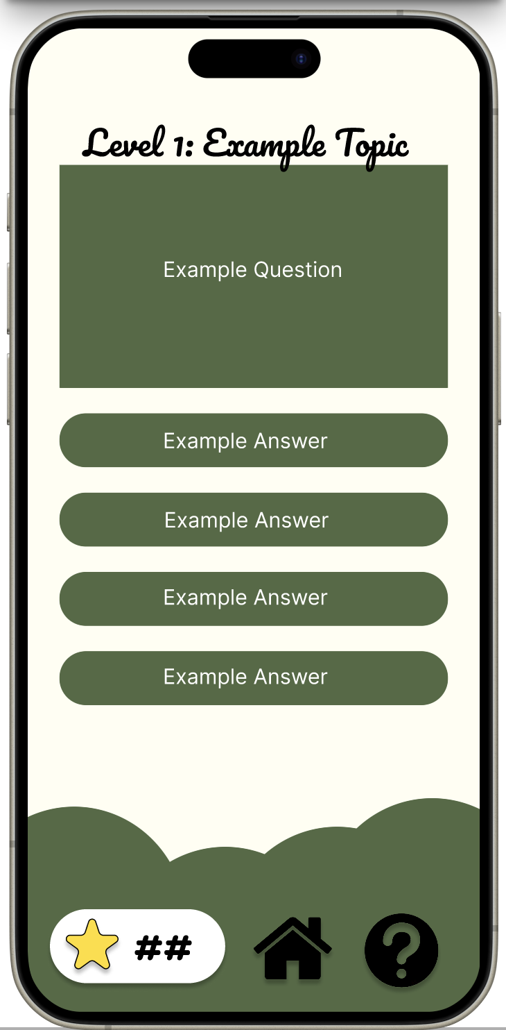
Demos

Slide 20
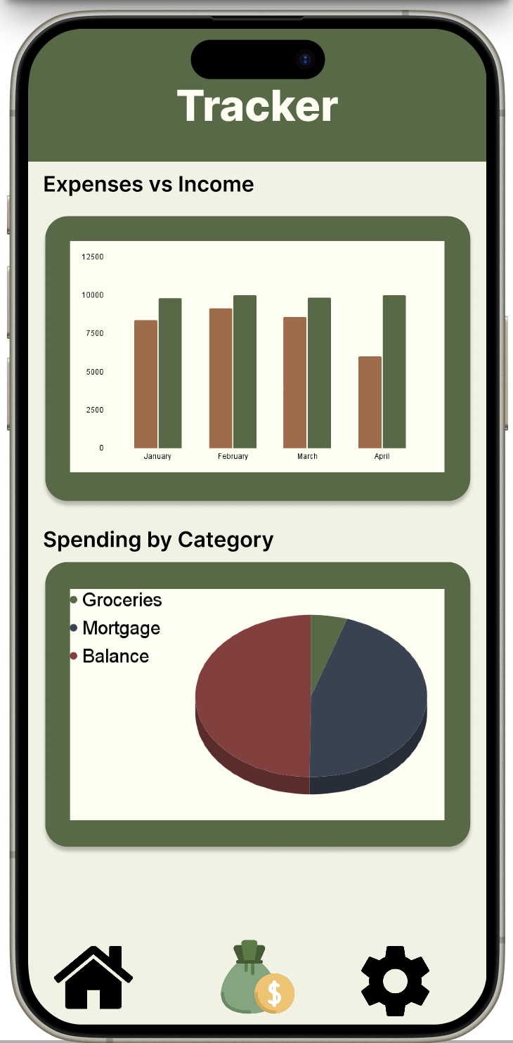
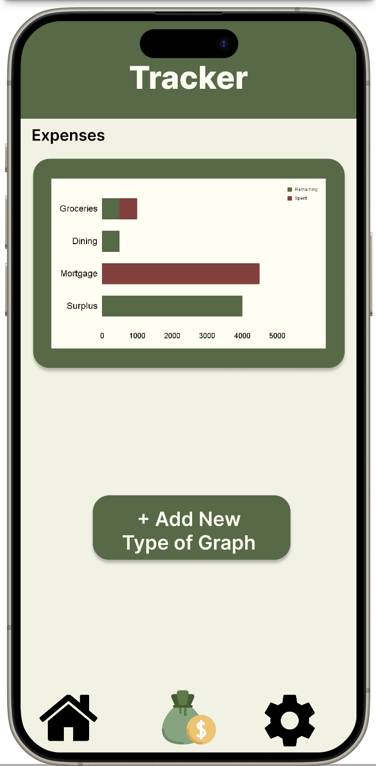
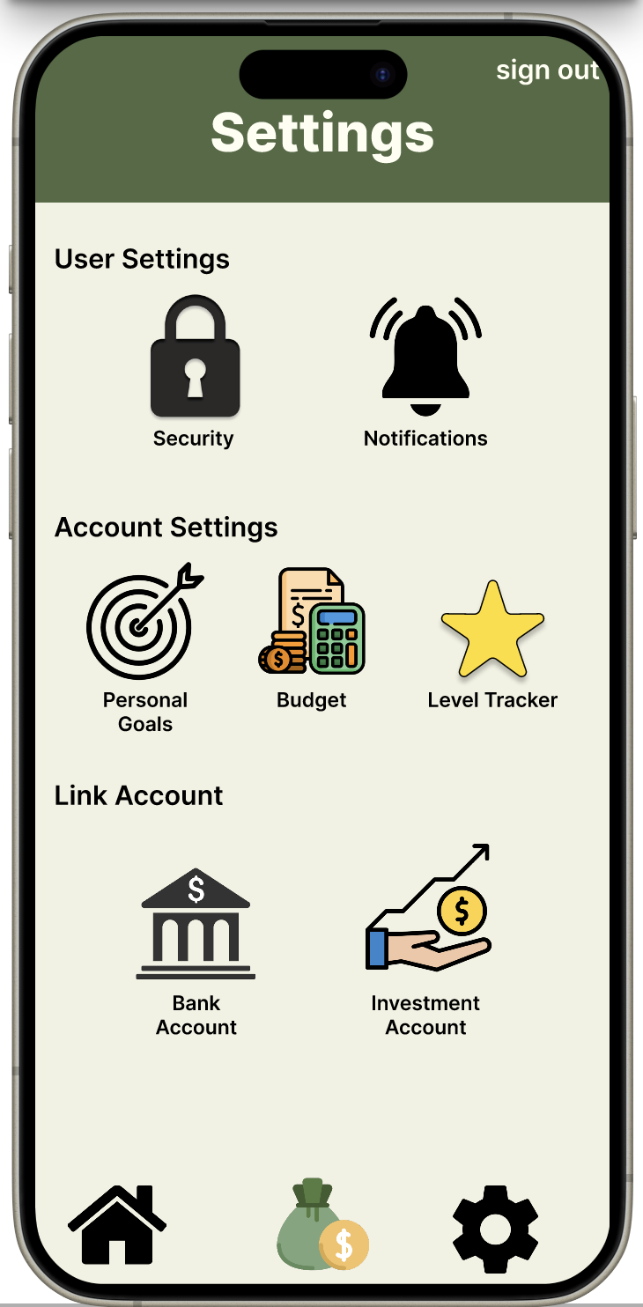
Demos

Slide 21
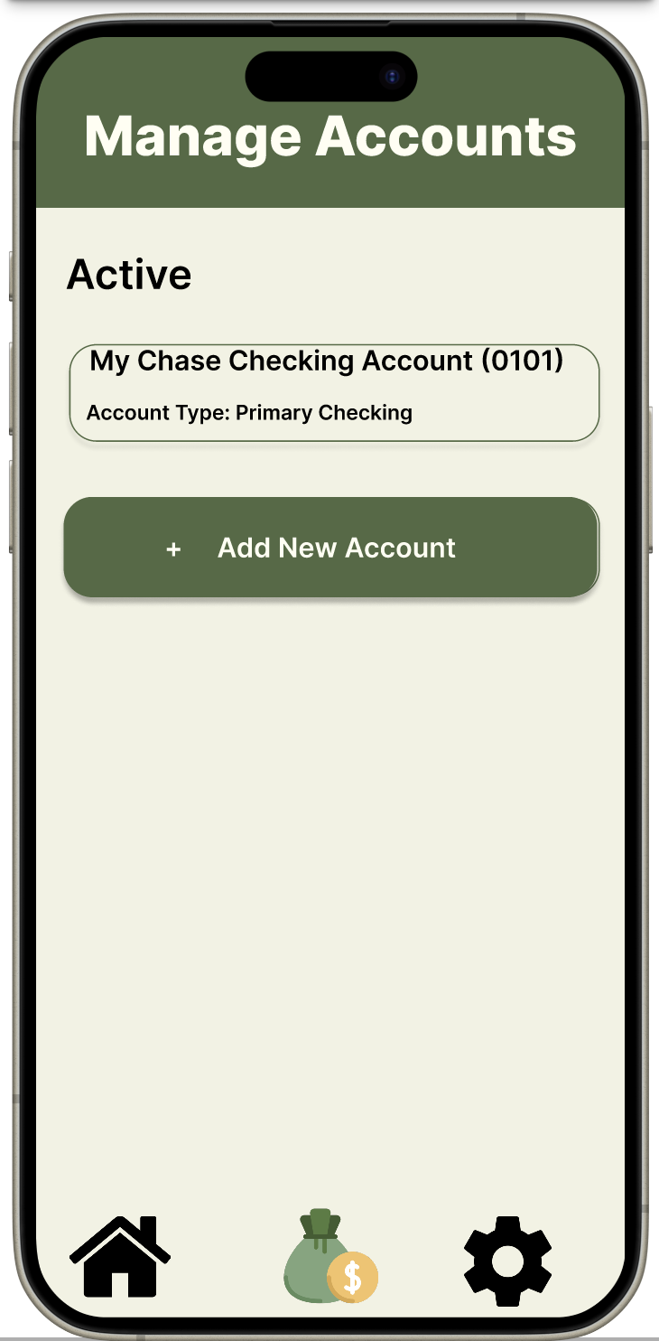
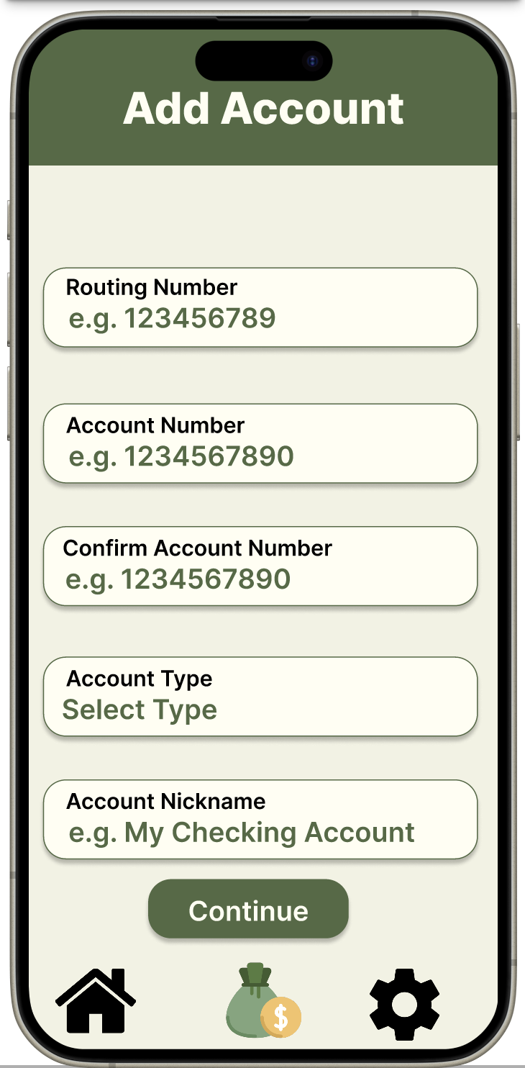
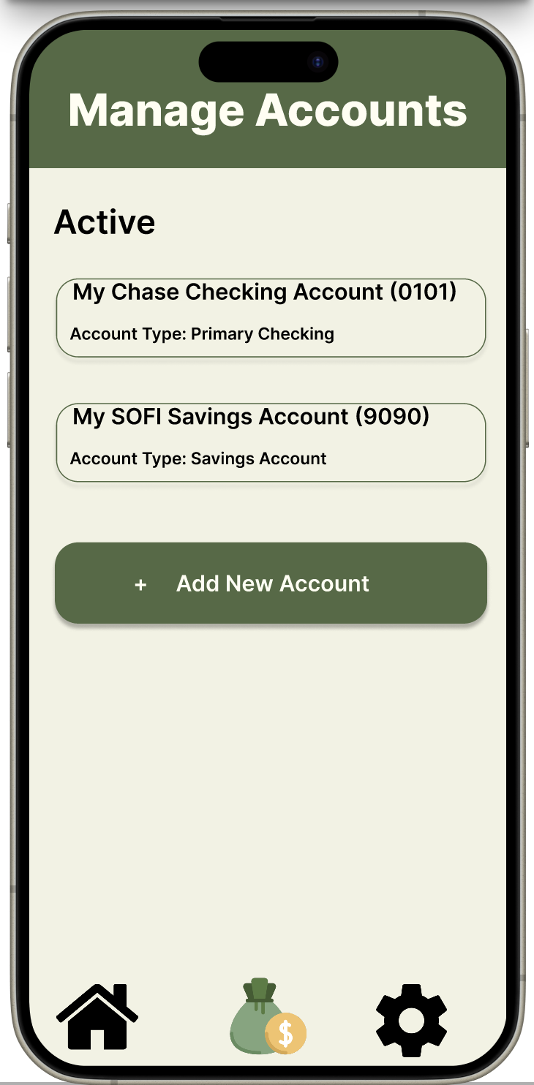
Demos

Slide 22
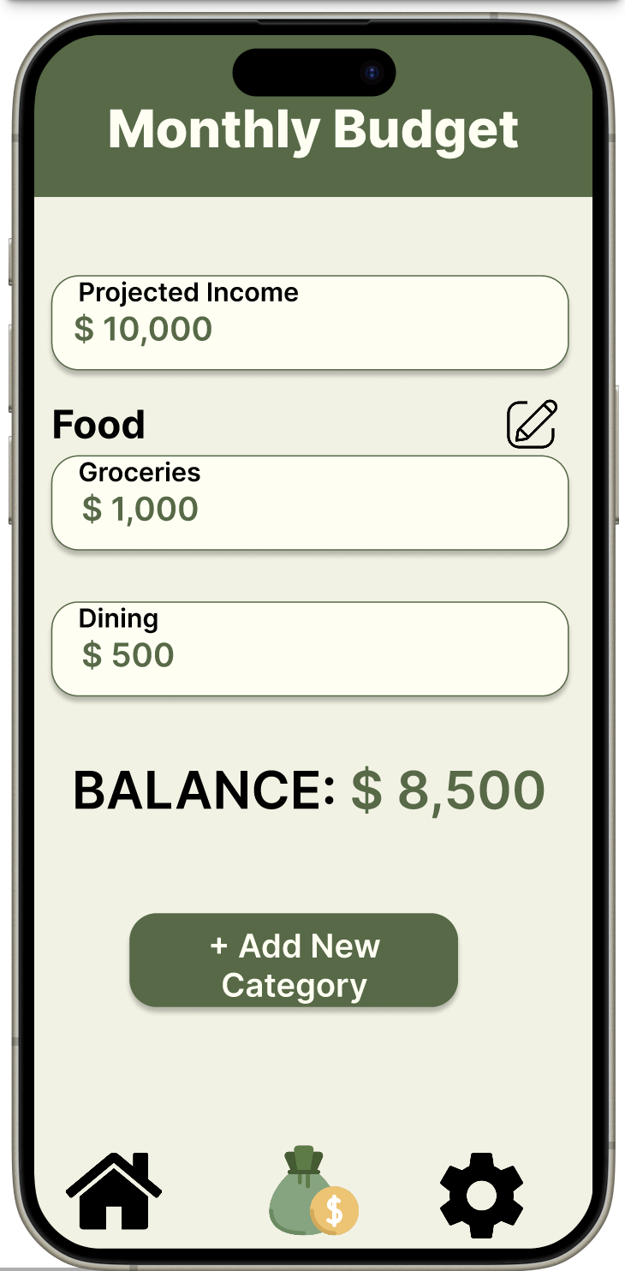
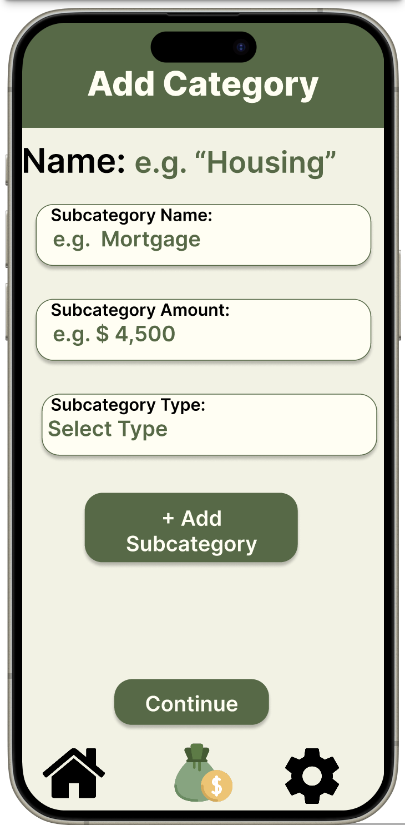
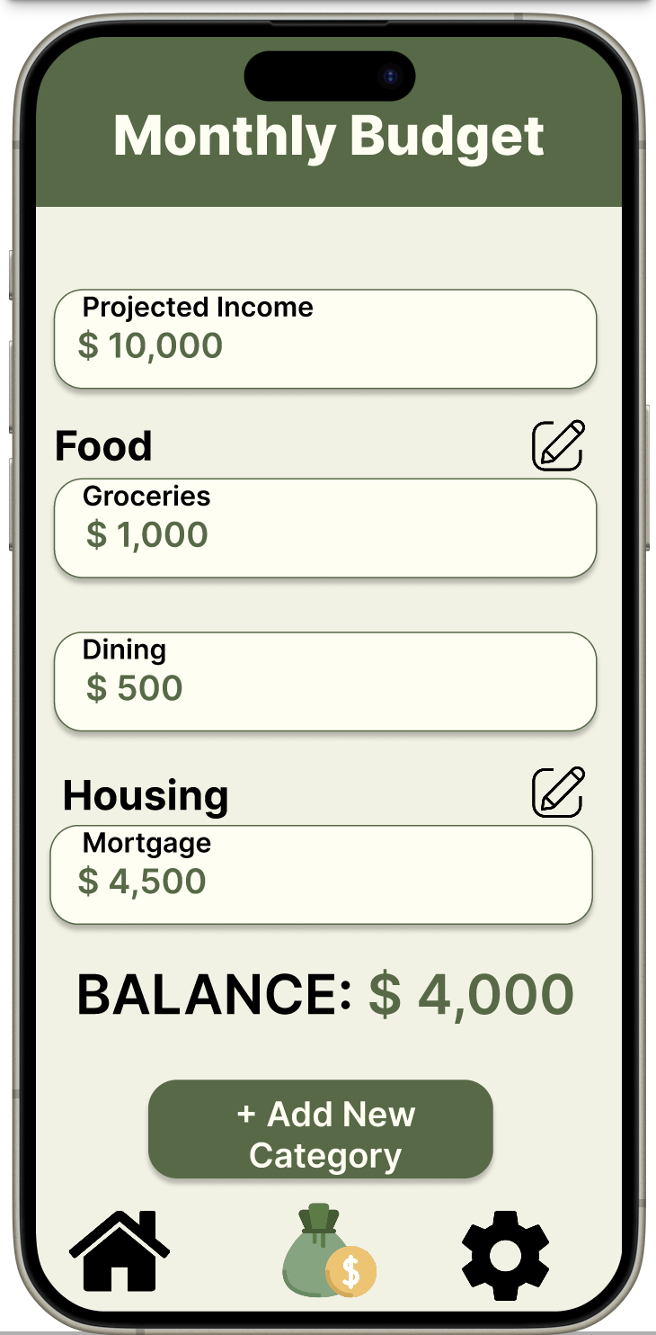
Demos

Slide 23
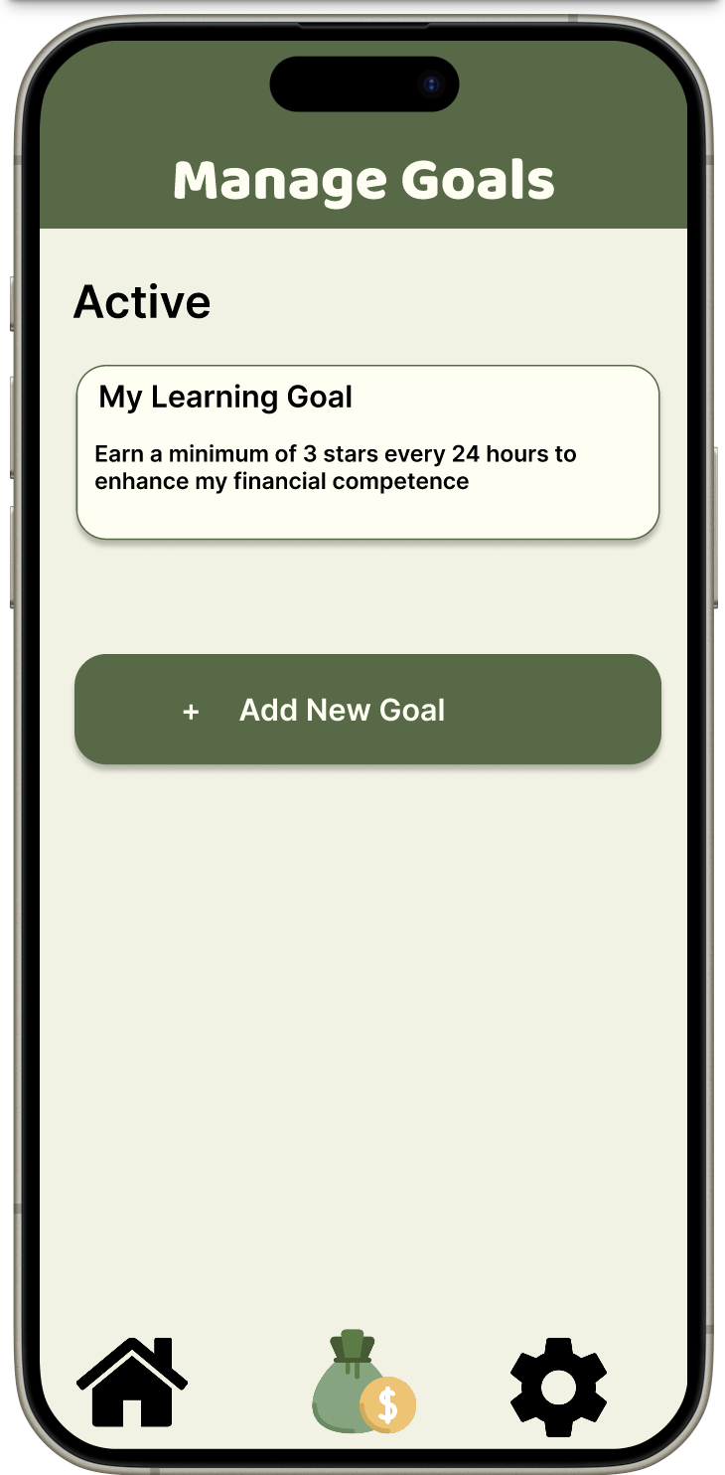
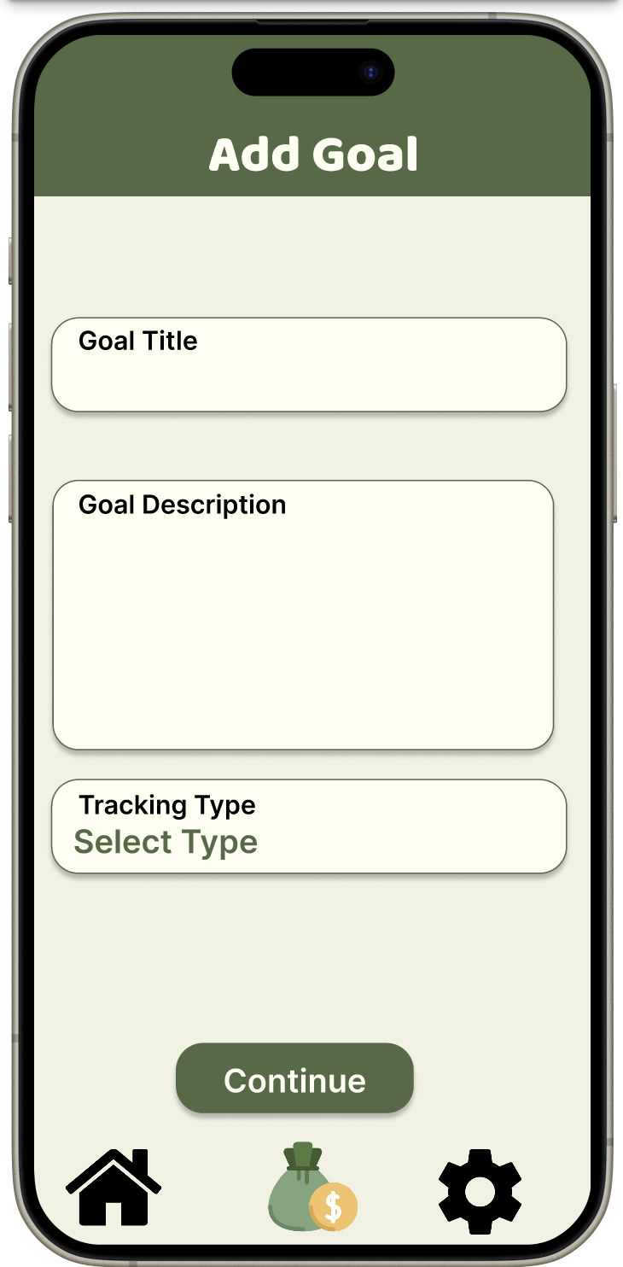
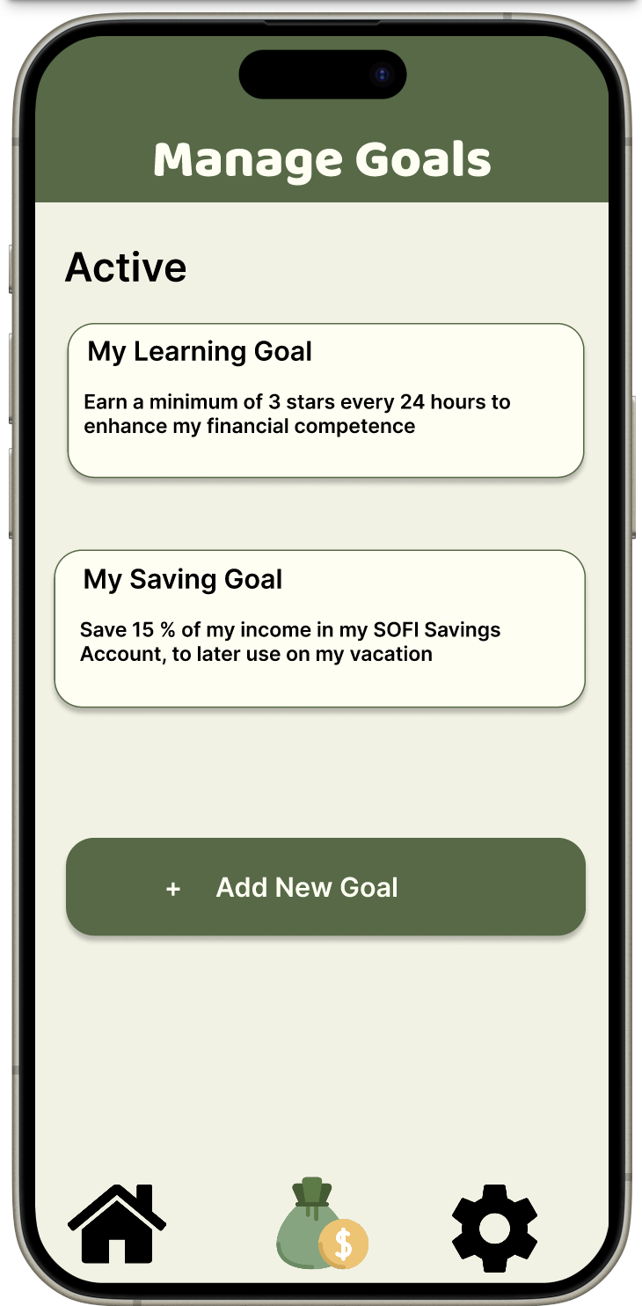
Demos

Slide 24
Comparison with Similar Work
NerdWallet:
Offers budgeting tools like transaction tracking, budget planning, and goal setting.
Users monitor cash flow, adhere to budget guidelines, and track net worth and credit scores.
Our app stands out with gamified financial education, enhancing financial literacy.
YNAB (You Need a Budget):
Follows zero-based budgeting, emphasizes proactive planning, and links financial accounts.
Provides educational resources but lacks gamification.
Our app introduces gamified learning, aiming for engaging budget planning.

Slide 25
Conclusion
Our project remained aligned with the initial vision: a unique budgeting app merging spending tracking and gamified financial education.
Collaboration ensured seamless integration of design elements.
Comparative analysis with NerdWallet and YNAB refined our strategy.
Meticulous planning laid a solid foundation for future development.
Commitment to refining the design based on user feedback ensures a seamless user experience.
Moving forward, our goal is to deliver a comprehensive and user-friendly budgeting application, enhancing financial literacy effectively.

Slide 26
References
[1] Amazon, "Amazon EC2," amazon.com. [Online]. Available: https://aws.amazon.com/ec2/. [Accessed Apr. 19, 2024].
[2] Amazon, "Amazon Elastic Block Store," amazon.com. [Online]. Available: https://aws.amazon.com/ebs/. [Accessed Apr. 19, 2024].
[3] Amazon, "AWS Pricing Calculator," calculator.aws. [Online]. Available: https://calculator.aws/#/. [Accessed Apr. 19, 2024].
[4] Atlassian, "BitBucket," bitbucket.org. [Online]. Available: https://bitbucket.org/. [Accessed Apr. 19, 2024].
[5] Atlassian, "BitBucket Pricing," atlassian.com. [Online]. Available: https://www.atlassian.com/software/bitbucket/pricing. [Accessed Apr. 19, 2024].
[6] Atlassian, "Jira Software," atlassian.com. [Online]. Available: https://www.atlassian.com/software/jira. [Accessed Apr. 19, 2024].
[7] Atlassian, "Jira Software features," atlassian.com. [Online]. Available: https://www.atlassian.com/software/jira/features. [Accessed Apr. 19, 2024].
[8] Atlassian, "Jira Software Pricing," atlassian.com. [Online]. Available: https://www.atlassian.com/software/jira/pricing. [Accessed Apr. 19, 2024].
[9] Plaid, Inc., "Auth," plaid.com. [Online]. Available: https://plaid.com/products/auth/. [Accessed Apr. 19, 2024].
[10] NerdWallet, Inc., "NerdWallet," nerdwallet.com. [Online]. Available: https://www.nerdwallet.com/. [Accessed Apr. 19, 2024].
[11] B. O'Shea and L. Schwahn , "Budgeting 101: How to Budget Money," NerdWallet, Inc., Feb. 16, 2024. [Online]. Available: https://www.nerdwallet.com/article/finance/how-to-budget. [Accessed 2024 19 April].
[12] YNAB, "YNAB," ynab.com. [Online]. Available: https://www.ynab.com/. [Accessed Apr. 19, 2024].
[13] YNAB, "Why YNAB is different," ynab.com. [Online]. Available: https://www.ynab.com/why-ynab-is-different. [Accessed Apr. 19, 2024].
[14] YNAB, "Our App Lineup," ynab.com. [Online]. Available: https://www.ynab.com/our-app-lineup. [Accessed Apr. 19, 2024].

